Slide 1
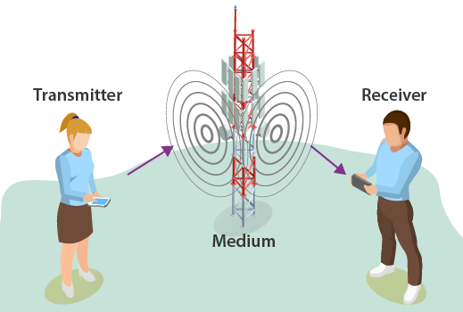

Introduction to Communication System
Sirisha Tadepalli

Slide 2
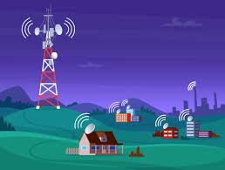
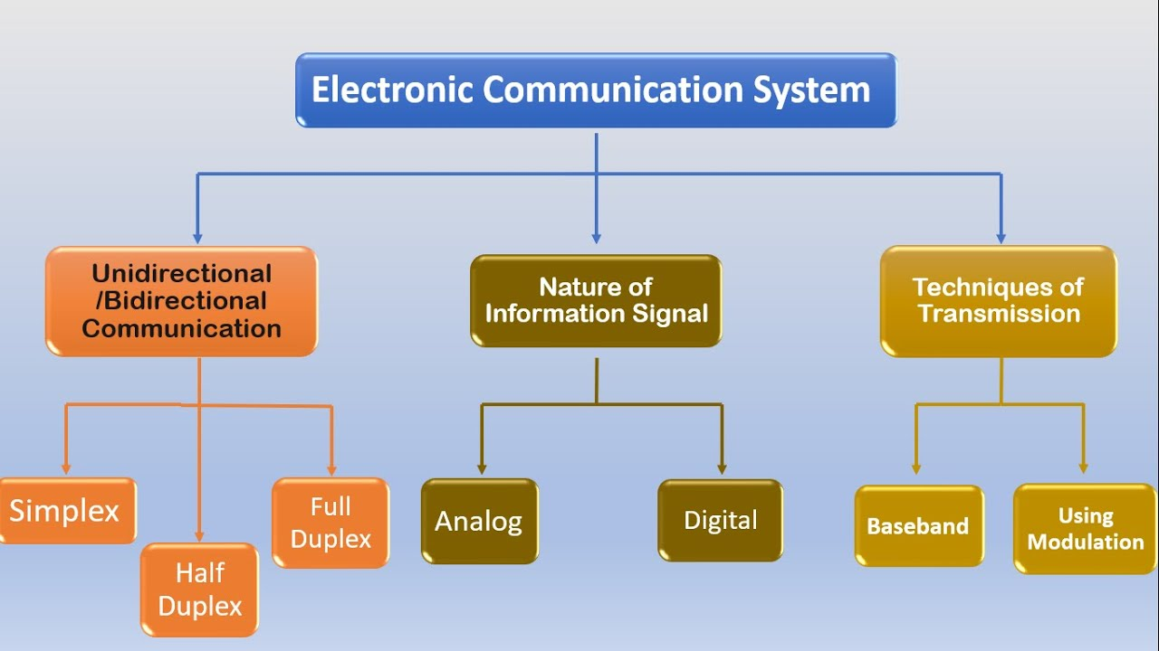
What is a Communication system?
The transmission of information is called communication
Information can be exchanged by one-to-one or one-to-many or many-many (Fig. 2)
It can be wired or wireless (Electronics view)
Fig. 2 Basic Information can be transmitted: one-to-many
Ex: Radio Broadcasting [3]
Fig.1 Basic classification of an electronic communication system [4]
Notes:
https://www.youtube.com/watch?v=qhjj6WG7Rgc

Slide 3
Why communication engineering for AI?
Foundational understanding for applying AI models
Ex: Human-machine interaction, Machine-to-machine interaction, Computer Vision, and Natural language processing (NLP)
Hardware Interaction: Many AI systems are designed to interact with the physical world through sensors and actuators.
Understanding communication engineering principles helps you grasp how these devices convert data into electrical signals and vice versa. Ex: IoT
Efficient Data Transmission: Communication engineering knowledge equips you with techniques for optimizing data transmission and minimizing errors. Ex: Autonomous vehicles
Notes:
Computer Vision (CV): Facial recognition systems, Self-driving cars, Augmented reality (AR) GPS
NLP: Voice assistants: SIRI,ALEXA. Machine translation, Smart replies and text suggestions:

Slide 4
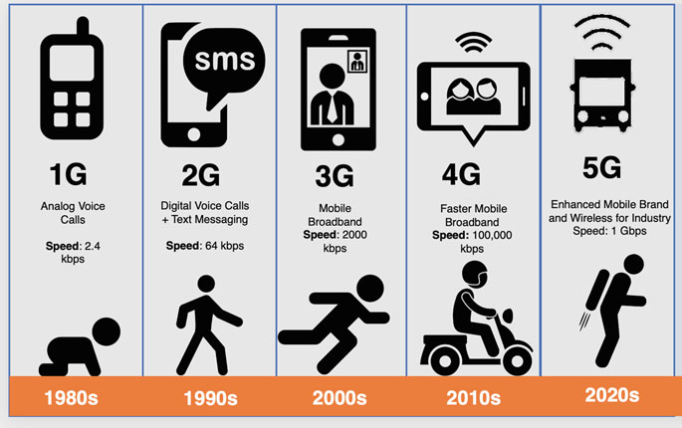
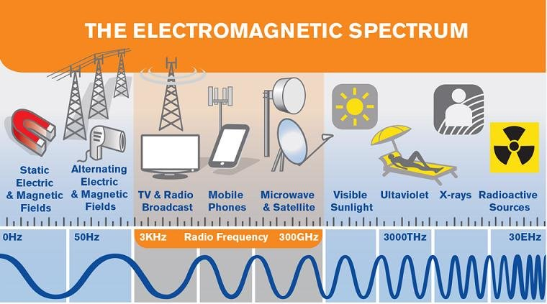
Evolution of mobile technology

Slide 5
Syllabus
Unit 1
Introduction to communication systems, introduction to signals, different types of signals and their characteristics, concept of system, linear time-invariant (LTI) system, sinusoids- concept of frequency, in-phase and quadrature component, bandwidth, pass band and stop band, Introduction to SDR platforms and devices- MATLAB Simulink and GNU radio Companion (GRC), RTL-SDR and Adalm Pluto. Signal analysis/ spectrum analysis and visualization using SDR tools.
Unit 2
Need for modulation, analog modulation schemes, amplitude modulation (AM) and its types - AM-DSB-SC, AMDSB-TC, SSB. AM Demodulation schemes, angle modulation- frequency modulation (FM) -Narrowband and wideband, phase modulation, FM demodulation, implementation of analog modulation/demodulation schemes using SDR tools.
Unit 3
Quadrature amplitude modulation and demodulation, pulse analog modulation schemes, digital carrier modulation/demodulation Schemes- amplitude shift keying (ASK), frequency shift keying (FSK), phase shift keying (PSK), M-ary signaling, BPSK, QPSK, implementation of digital modulation/demodulation schemes using SDR tools. Multicarrier modulation- OFDM, MIMO, Prospects of AI in communication system- radio signal or modulation classification.

Slide 6
Reference textbooks
B1. Wyglinski, Alexander M., Robin Getz, Travis Collins, and Di Pu. Software-defined radio for engineers. Artech House, 2018.
B2. Qasim Chaudhari, Wireless Communications from the Ground Up: An SDR Perspective, 2018
B3. Andrew Barron, Software Defined Radio: for Amateur Radio Operators and Shortwave Listeners, 2019
B4. C.R. Johnson and W.A. Sethares, Software Receiver Design: Build Your Own Digital Communication System in Five Easy Steps, Cambridge University Press, 2011
B5. Proakis, John G., Masoud Salehi, and Gerhard Bauch. Contemporary communication systems using MATLAB. Cengage Learning, 2012.
B6. Wyglinski, Alexander M., and Di Pu. Digital communication systems engineering with software defined radio. Artech House, 2013.

Slide 7
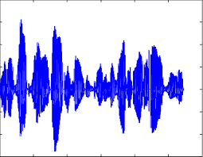
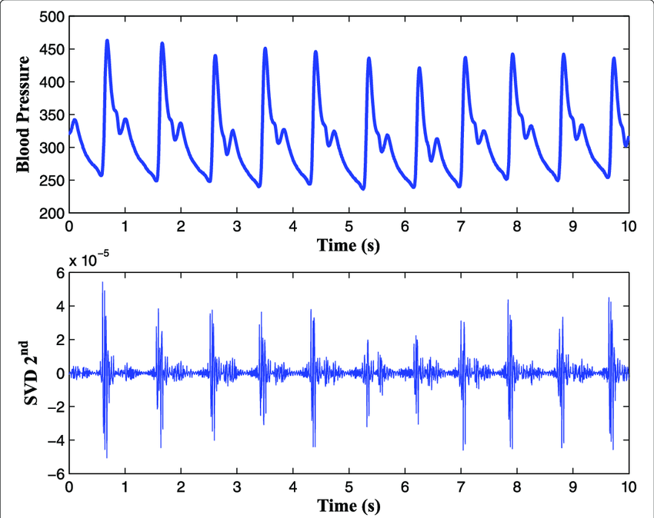
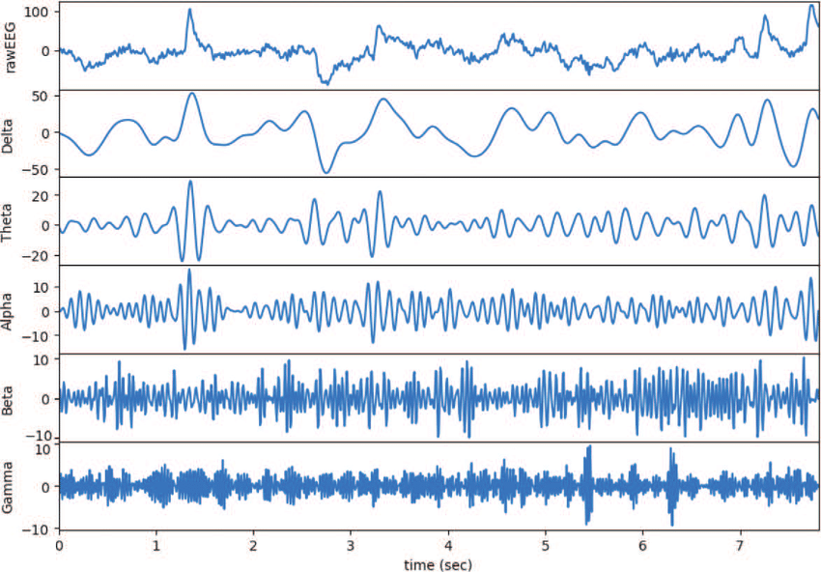
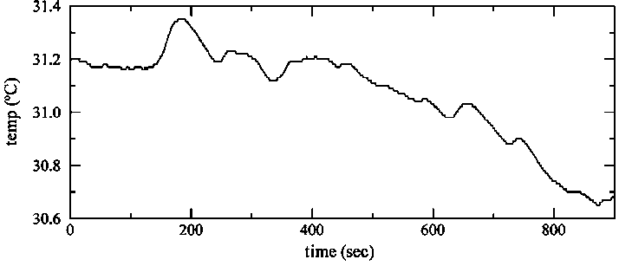
Introduction to signals
What is a signal?
A fundamental quantity of representing information
Information can be of any form
Ex: Analog, digital, Sound, temperature, intensity, Pressure, etc..,
Notes:
In maths it’s a function

Slide 8
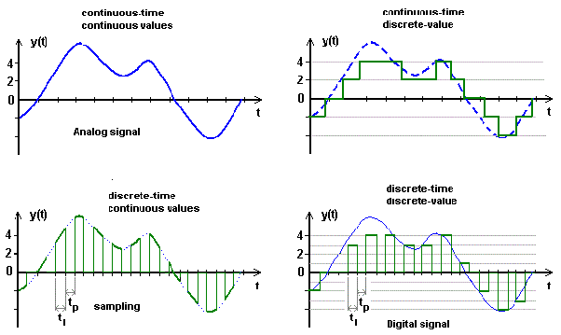
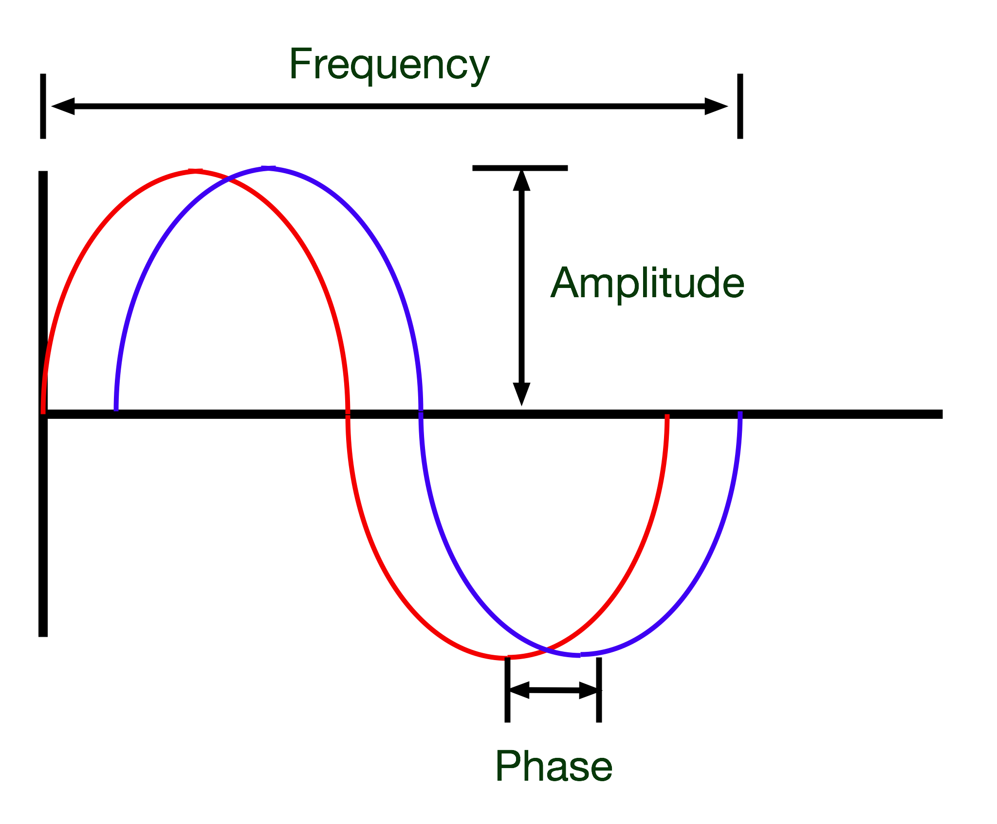
Types of Signals: or classification
1. Analog signal: continuous t and continuous y(t)
2. Continuous-time signal: continuous t and discrete y(t)
3. Discrete signal: discrete t and continuous y(t)
4. Digital signal: discrete t and discrete t
Characteristics of a signal
Amplitude (height)
Frequency (width)
Phase (angle)
1
2
3
4

Slide 9
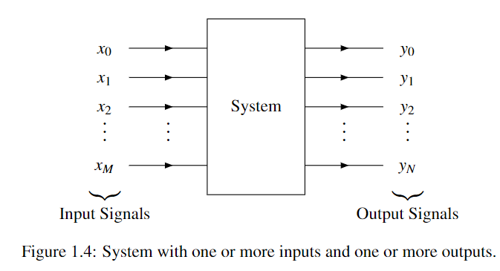
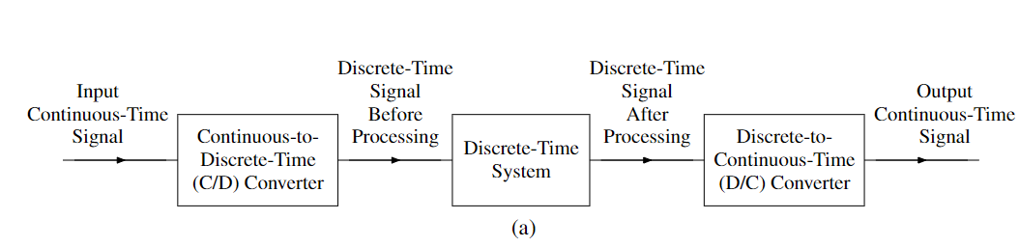
Classification of systems
A system is an entity that processes one or more input signals to produce one or more output signals
Classification:
No. of inputs: SISO, MIMO
Type of signal: Continuous-time system, discrete-time, hybrid system, and digital or analog systems
One-dimensional and multi-dimensional
Example: Speech recognition system
Amplification and noise reduction
ECG abnormalities detection system

Slide 10
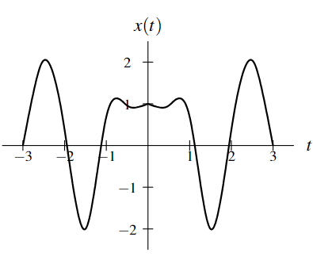
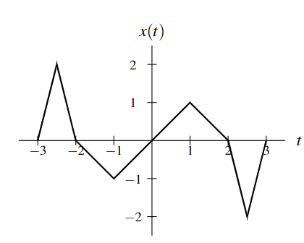
Symmetry of Functions and Sequences
Even
Even and Odd signals
A function x is said to be even if it satisfies
x(t) = x(-t) or x(n) = x(-n)
Geometrically, an even function or sequence is symmetric with respect to the vertical axis
A function x is said to be odd if it satisfies
x(t) = - x(-t) for all t (where t is a real number)
x(n) = −x(−n) for all n (where n is an integer)
One can easily show that an odd function or sequence x must be such that x(0) = 0, assuming that the domain of x includes 0
Odd

Slide 11
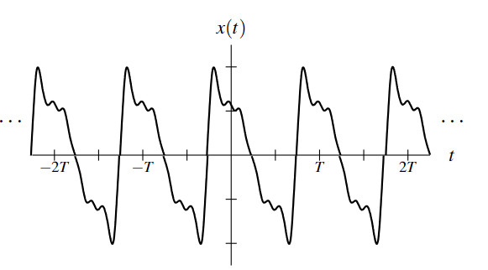
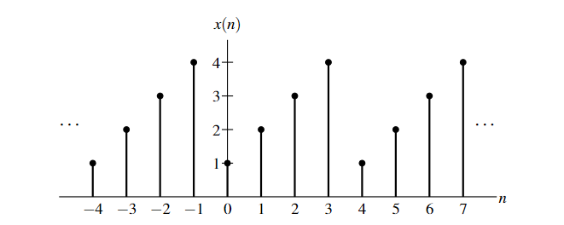
Periodicity of Functions and Sequences
A function x is said to be periodic with period T (or simply T -periodic) if, for some strictly positive real constant T
x(t) = x(t + T ) for all t (where t is a real number)
A T-periodic function x is said to have the frequency 1/T and angular frequency 2π/T
A sequence x is said to be periodic with period N (or simply N-periodic) if, for some strictly positive integer N,
x(n) = x(n + N) for all n (where n is an integer)
An N-periodic sequence x is said to have a frequency 1/N and angular frequency 2π/N
A function or sequence that is not periodic is said to be Aperiodic.

Slide 12
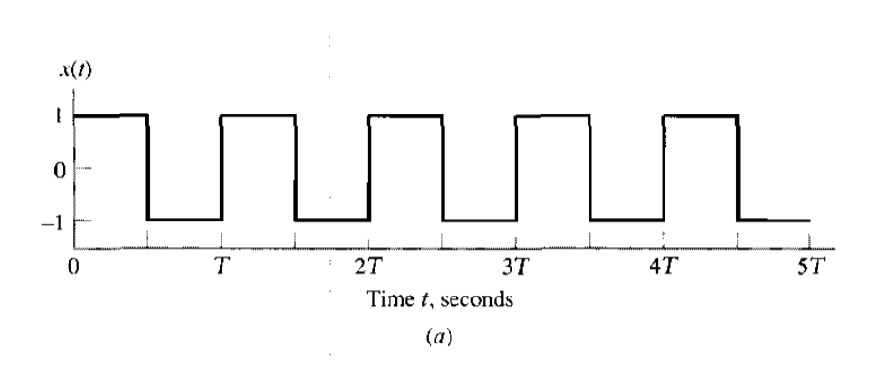
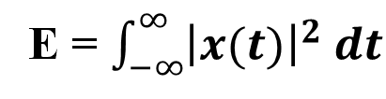
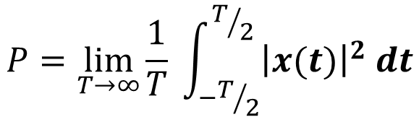
What is the frequency of the signal? If T =0.2s
Signal Energy and Power
The energy E contained in the function x is defined as
The average power P contained in the function x is given by
E = $\int_{−∞}^{∞}{{\left|x(t)\right|}^{2} dt}$
$$P=\lim_{T→∞}{\frac{1}{T}} \int_{−T/2}^{T/2}{{\left|x(t)\right|}^{2} dt}$$

Slide 13
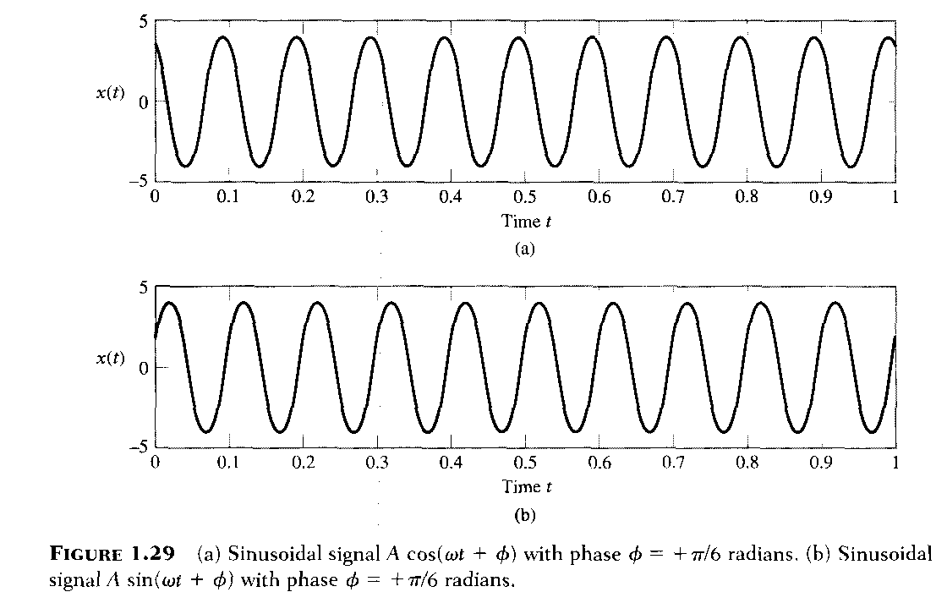

Slide 14
Unit step Function
The unit-step function (also known as the Heaviside step function), denoted u(t), is defined as
Ramp function
Ramp function, r(t) is defined as

Slide 15
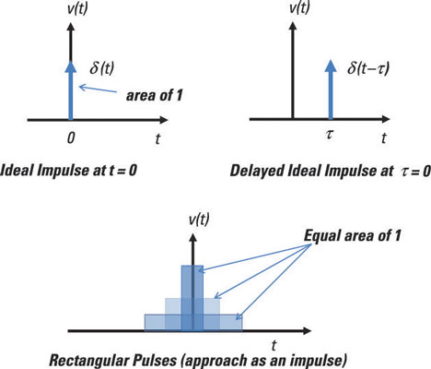
Linear time-invariant system (LTI)
Why the LTI system?
The effect of a system on the spectrum of a signal can be analyzed easily if and only if the system is LTI
Impulse response
x(t) = δ (t) y(t) = h(t)
unit impulse Impulse response
The impulse response completely characterizes the behavior of an LTI system
δ[n − i] → LTI → h[n − i] (Time-invariance–works for any constant i)
System
Notes:
https://www.castle.cloud/gnuradio-for-windows/download/- GNUcompanion

Slide 16
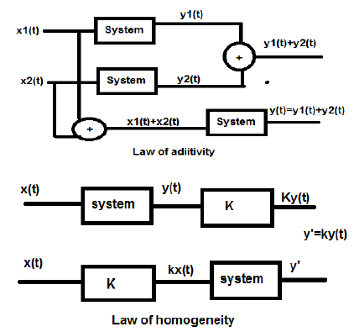
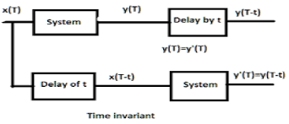
Linear time-invariant system (LTI)
Linear system and Time invariant system → LTI system
Linear system follows superposition: Law of additivity and Law of homogeneity
Time invariant system

Slide 17
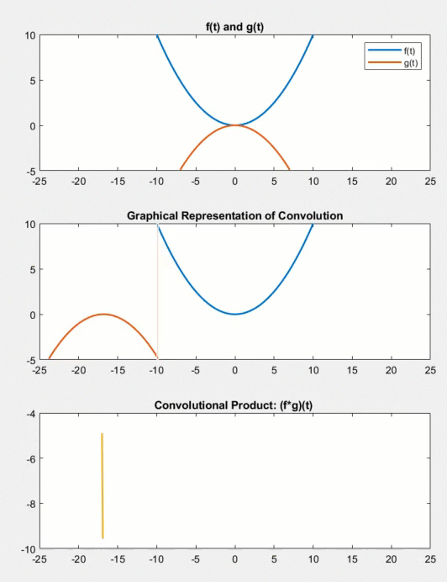
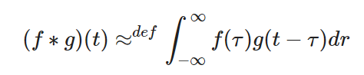
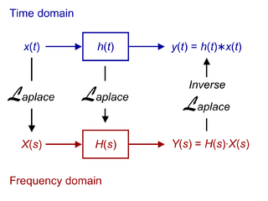
Linear time-invariant system (LTI)
convolution is an integral that expresses the amount of overlap of one function 𝑓(𝑡), as it is shifted over function 𝑔(𝑡), for a continuous-time signal it is expressed as:

Slide 18
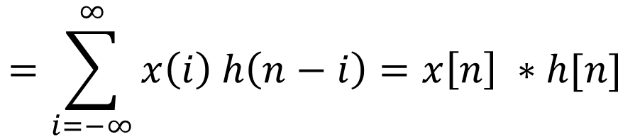
Linear time-invariant system (LTI)
For a Discrete signal
x[n] → LTI → y[n]
$$=\sum_{i=−∞}^{∞}{x\left(i\right) h\left(n−i\right)=x\left[n\right] ∗h[n] }$$
If the length of vector x is N and the length of vector h is M
The response vector Y of length M+ N -1:
In other words, length(y) = length(x) + length(h)- 1:
If the nonzero values of x[n] are in the interval [ax, bx] and the nonzero values of h[n] are in the interval [ah, bh] then the nonzero values of the output y[n] are in the interval [ax + ah, bx + bh]:

Slide 19

Qn. Consider an LTI system with impulse response
Find the response of the system to input signal
Sol:
$$x\left[n\right]=δ\left[n\right]$$
Since both
Similarly, we can obtain

Slide 20
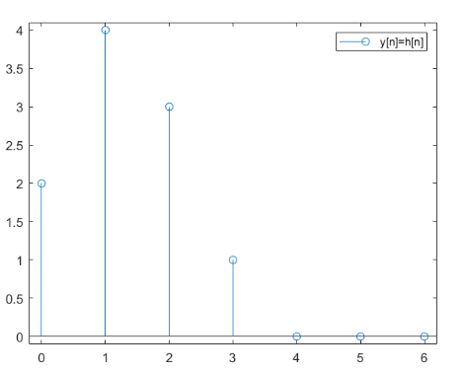
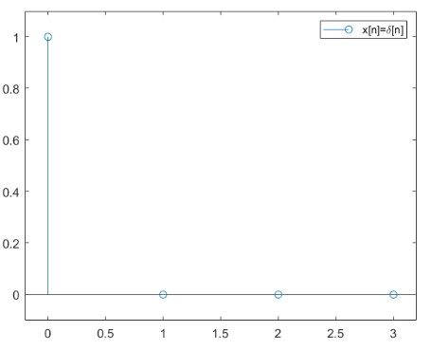
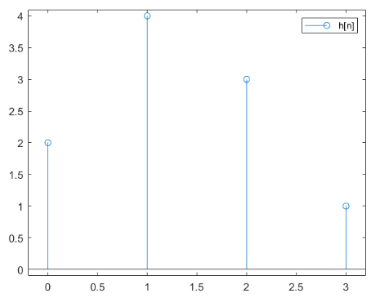
Verification : Computationally
What will be the response y[n] for input $δ\left[n−1\right]$ ?

Slide 21
